Slide 2


Learning objectives
In this lesson you will learn to:
  define 'AND', 'NOT', and 'OR’
  construct truth tables for Boolean operators and combinations
  use relational and logical operators in flowcharts and code.
For more information on this topic and additional student activities, see Topic 1.5 of the student book.
© Pearson Education Ltd 2020. Copying permitted for purchasing institution only.
Notes:
Specification content: 1.2.1 1.2.3 1.3.1 6.1.2 6.5.3

Slide 3
Boolean
You have used Boolean variables in your code.
Remember that in programming a Boolean can be only True or False.
Another application of Boolean is in the use of logical operators in programming.
When you looked at selection, you used the relational operators (<>, ==, etc.).
Logical operators are an additional tool that will enable you to make decisions in a program.
© Pearson Education Ltd 2020. Copying permitted for purchasing institution only.

Slide 4
String indexing
There are three Boolean operators that you need to be able to use.
These are:
        AND
        OR
        NOT
  You will use these to combine conditions to make more complex decisions.
  In Python these are:
and
or
not
© Pearson Education Ltd 2020. Copying permitted for purchasing institution only.

Slide 5
Truth tables
You need to understand how the operators work.
In order to do this, you need to represent all possible inputs and outputs in a truth table.
Use ‘1’ to represent True and ‘0’ to represent False.
© Pearson Education Ltd 2020. Copying permitted for purchasing institution only.

Slide 6
Truth tables
AND operator - be must be true for the whole statement to be true.
AND takes exactly two inputs and produces exactly one output.
Input A | Input B | Output
0 | 0 | 0
0 | 1 | 0
1 | 0 | 0
1 | 1 | 1
Remember:
0 means False
1 means True
© Pearson Education Ltd 2020. Copying permitted for purchasing institution only.
Notes:
Pi, gravity, VAT

Slide 7
OR
OR operator - then either one must be true for the whole statement to be true.
OR takes exactly two inputs and produces exactly one output.
Input A | Input B | Output
0 | 0 | 0
0 | 1 | 1
1 | 0 | 1
1 | 1 | 1
Remember:
0 means False
1 means True
© Pearson Education Ltd 2020. Copying permitted for purchasing institution only.

Slide 8
NOT
The NOT operator is placed before a condition, e.g. NOT x.
If the condition (x) is true, then the whole statement is false.
If the condition is false, then the whole statement is true.
In other words, it reverses the result of evaluating the statement to the right.
NOT takes exactly one input and produces exactly one output.
This operator is sometimes known as an ‘inverter’.
Remember:
0 means False
1 means True
Input A | Output
0 | 1
1 | 0
© Pearson Education Ltd 2020. Copying permitted for purchasing institution only.
Notes:
Student Activity 1

Slide 9
Compound conditional statements
You can use relational operators and logical operators together to form compound conditions. You could use these conditions in your if statements (selection).
Worked example:
Step 1 – evaluate the statements in the brackets (remember BIDMAS).
Step 2 – evaluate the logical operator.
(3 != 4) or (5 < 6)
(True) or (True)
True
© Pearson Education Ltd 2020. Copying permitted for purchasing institution only.
Notes:
Student Activity 2

Slide 10
Complex logical statements
You will often need to combine many logical and/or relational operators into a single statement.
You need to be able to work out what the outputs will be for all possible inputs.
There is an order of operations for logical operators that you need to remember:
  brackets
  not
  and
  or
© Pearson Education Ltd 2020. Copying permitted for purchasing institution only.

Slide 11
Worked example
Construct the truth table for this statement:
NOT A AND B
Order of precedence means we need to do the NOT A first, then take the result into AND B.
A | B | NOT A | AND B
0 | 0 | 1 | 0
0 | 1 | 1 | 1
1 | 0 | 0 | 0
1 | 1 | 0 | 0
Block off the column you don’t need to focus on the relevant columns.
© Pearson Education Ltd 2020. Copying permitted for purchasing institution only.
Notes:
Student Activity 3

Slide 12
Worked example
You use compound statements in a flowchart in just the same way you use simple statements.
For example, you are asked for an algorithm that will award a student a pass grade if their attendance is at least 85% and they have missed no assignments.
attendance >= 0.85 and missedAssignments == 0
Yes
output “pass”
No
output “fail”
© Pearson Education Ltd 2020. Copying permitted for purchasing institution only.

Slide 13
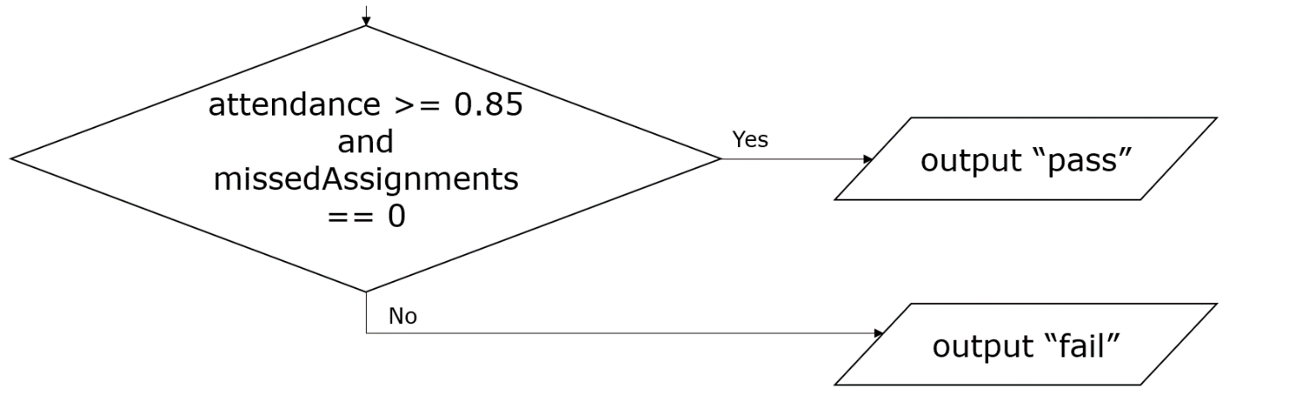
Worked example
Let’s translate this flowchart into python.
if attendance >= 0.85 and missedAssignments == 0:
print("pass")
else:
print("fail")
© Pearson Education Ltd 2020. Copying permitted for purchasing institution only.
Notes:
Student Activity 4

Slide 14
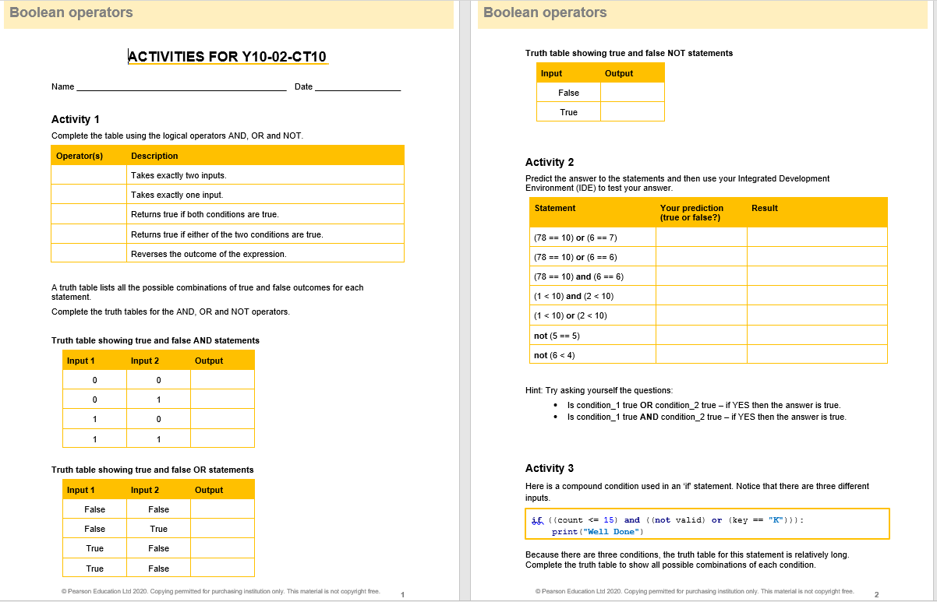
Activity Worksheet make sure that you have written enough of the task so that the answer makes sense in your books.
© Pearson Education Ltd 2020. Copying permitted for purchasing institution only.

Slide 15
Wrap up, you have learned how to . . .
Define 'AND', 'NOT', and ‘OR’.
  If two conditions are joined by the AND operator, then they must both be true for the whole statement to be true.
  If two conditions are joined by the OR operator, then either one or both must be true for the whole statement to be true.
  The NOT operator reverses the result of evaluating the statement to the right.
Construct truth tables for Boolean operators and combinations of Boolean and other operators.
  Truth tables show all possible combinations of inputs for a logical statement and the outputs it produces.
Use relational and logical operators in flowchart and code.
© Pearson Education Ltd 2020. Copying permitted for purchasing institution only.

